Slide 1
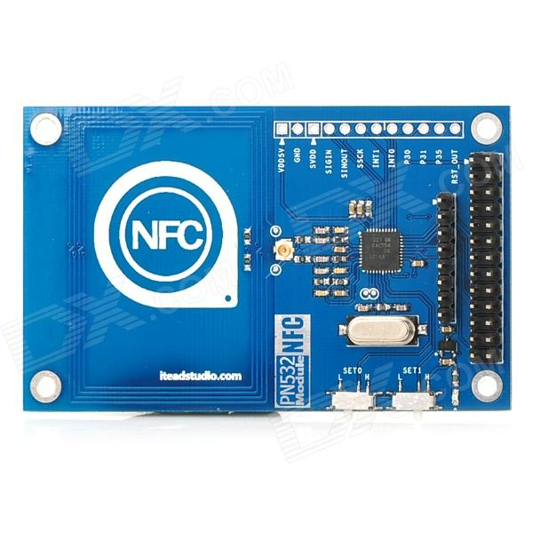
SCK 52
M 50
SDA 51
SCL 53
-
-
GND
5V

